Slide 1
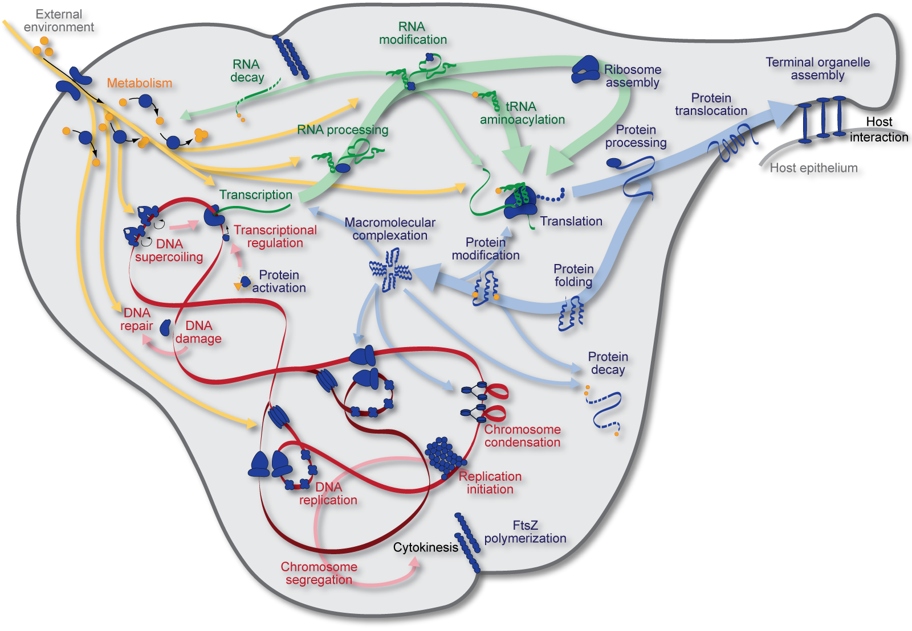

Introduction to whole-cell modeling
KarrLab.org
karr@mssm.edu
Jonathan Karr
April 3, 2016

Slide 2
Outline
Motivation
What is a WC model?
Challenges
Model building
State-of-the-art
Software tools
Open challenges

Slide 3
Outline
Motivation
What is a WC model?
Challenges
Model building
State-of-the-art
Software tools
Open challenges

Slide 4
Motivation
Basic science
What is life? How does life emerge?
Industrial manufacturing
Optimize yield Minimize cost
Agriculture
Optimize yield
Resist drought
Prevent infection
Medicine
Predict prognoses
Optimize therapy
Maximize quality of life
Central challenges
Understand how genotype determines phenotype
Design genomes which desired phenotypes

Slide 5
Barriers to bioengineering and medicine
Current approaches rely on trial-and-error
No complete understanding of biology
Cannot predict behavior
Statistical models rely on observations
Impossible to observe all mutations

Slide 6

Physics-based models enable rational engineering
Planes are designed with CAD and physics-based models
Cells could be designed with WC models

Slide 7

Example: drug biosynthesis

Slide 8
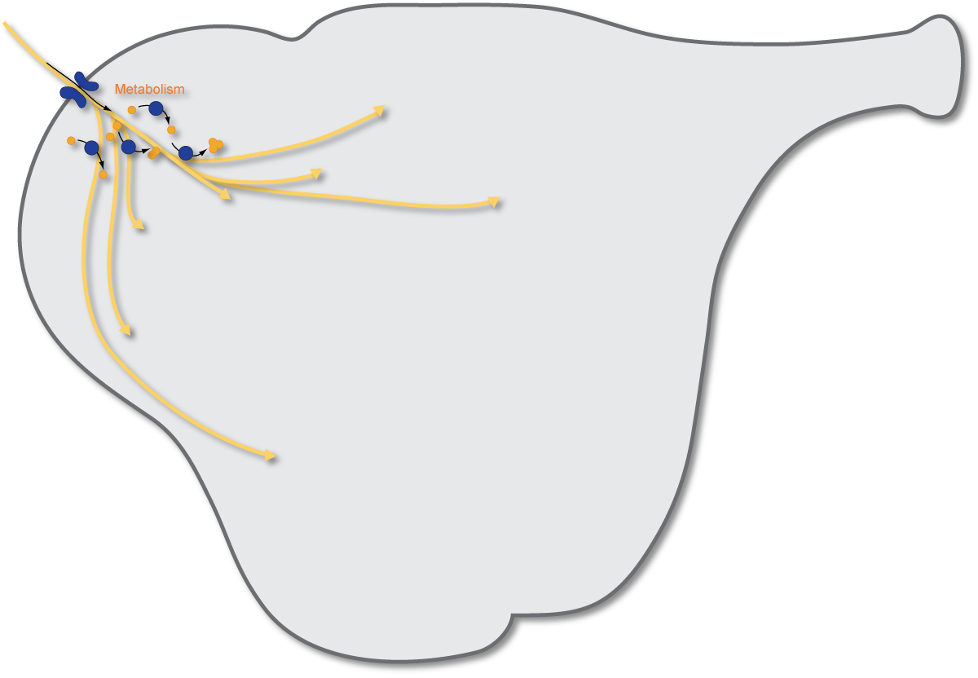
Example: drug biosynthesis

Slide 9
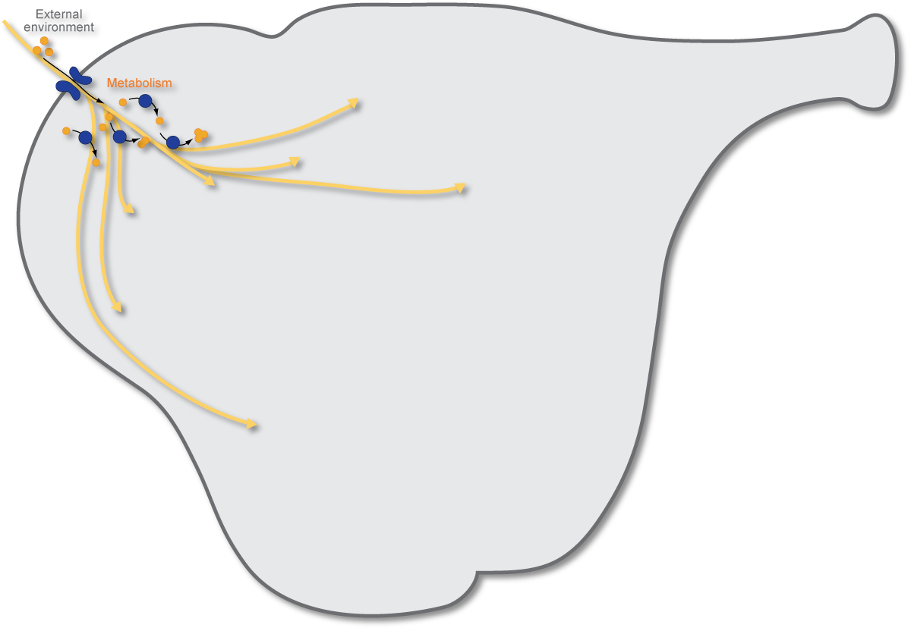
Example: drug biosynthesis

Slide 10
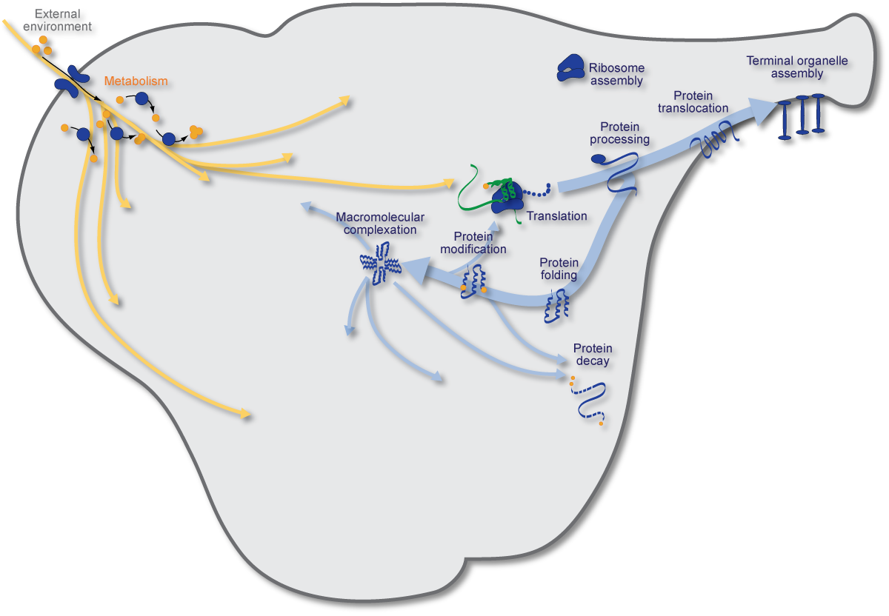
Example: drug biosynthesis

Slide 11
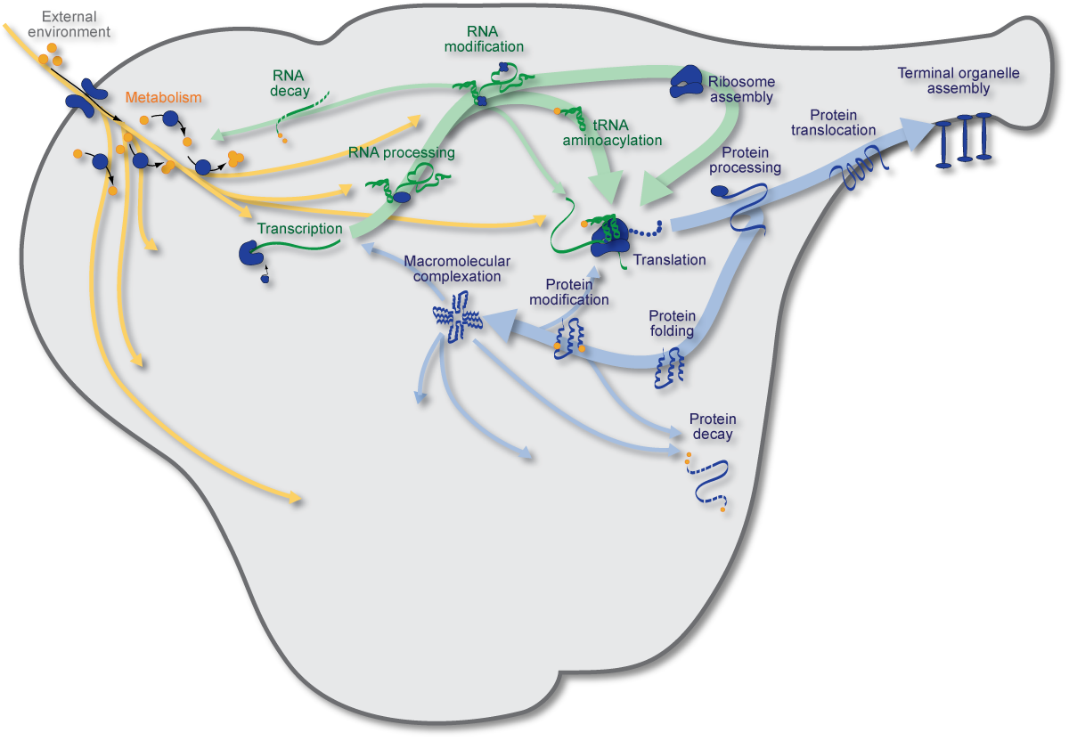
Example: drug biosynthesis

Slide 12
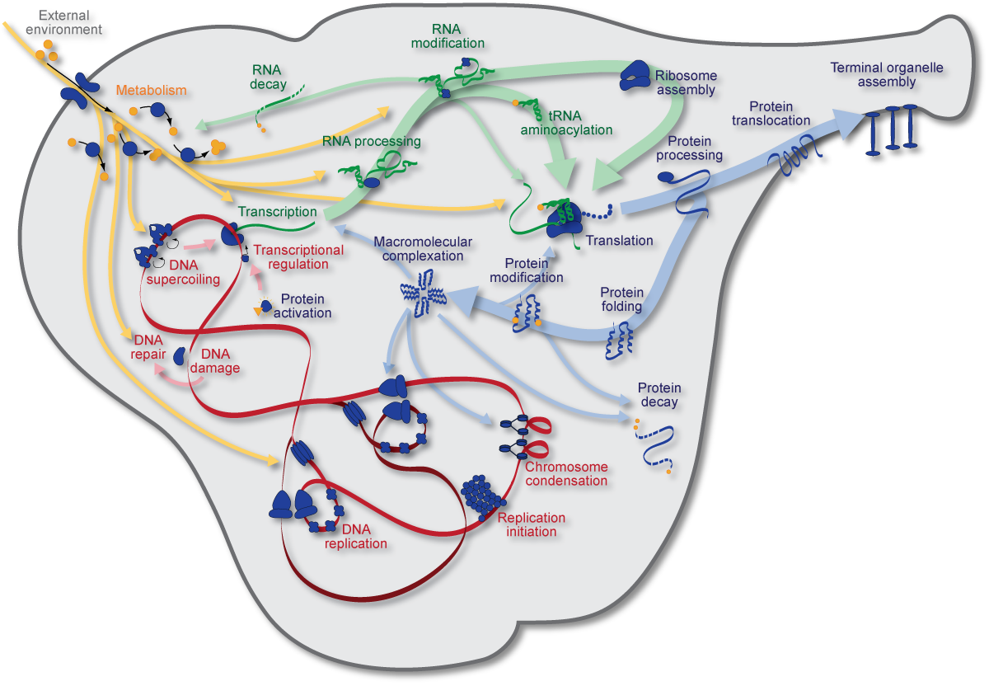
Example: drug biosynthesis

Slide 13
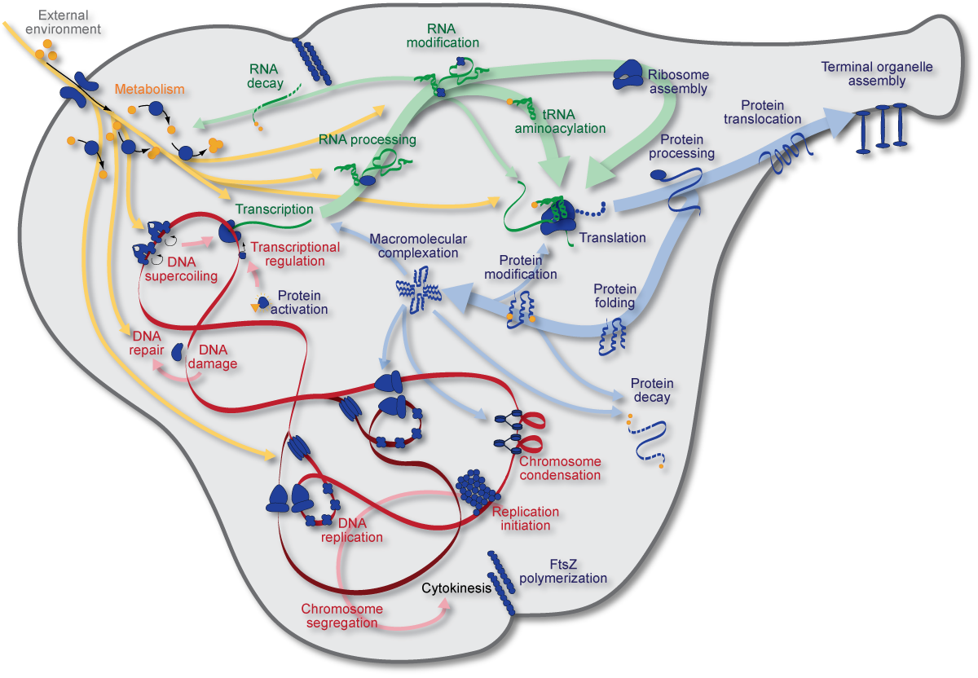
Example: drug biosynthesis

Slide 14
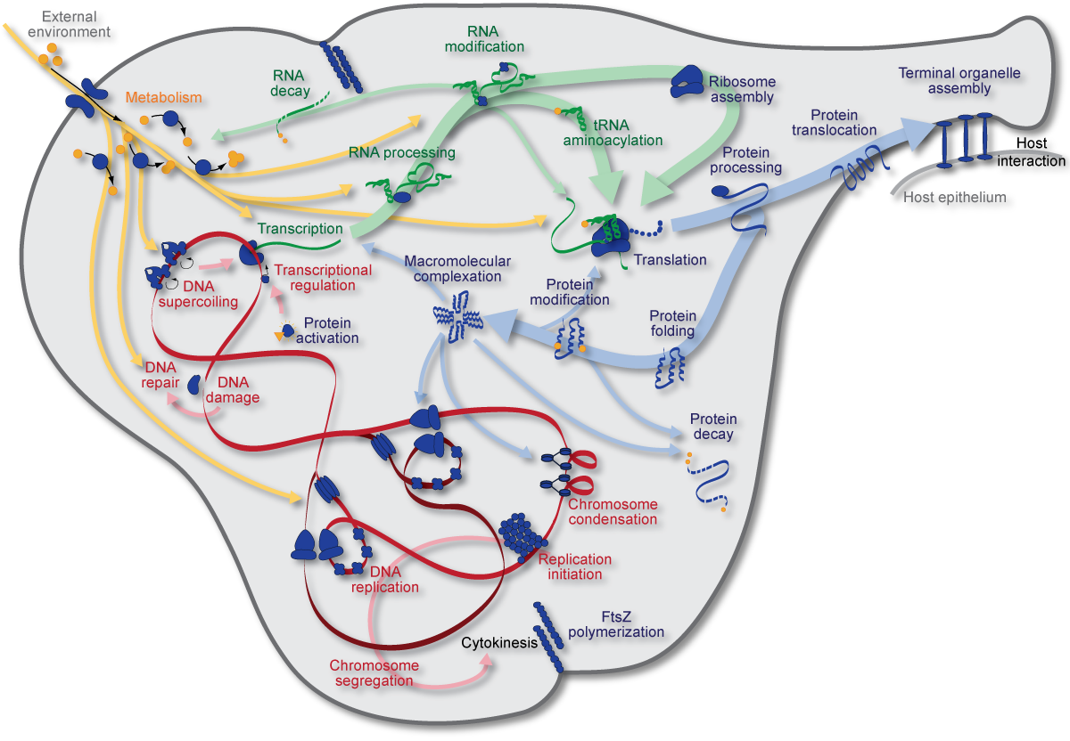
Example: drug biosynthesis
Designing genomes with specific phenotypes requires comprehensive WC models

Slide 15
Outline
Motivation
What is a WC model?
Challenges
Model building
State-of-the-art
Software tools
Open challenges

Slide 16






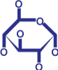

WC modeling principles
Temporally
complete
Single-cell
Species-specific
Mechanistic/dynamic
Genetically
complete
Stochastic
Molecularly
precise
Accurate
Karr et al., 2015
Notes:
Toward this goal we have built a gene-complete, computational model of a single bacterial cell which
Integrates all cellular processes into a single computational model, providing a unified understanding of cellular physiology, which
Predicts the dynamics of every molecule and process,
Can be used to guide experimental design and inform data analysis
Hopefully in the future, in concert with emerging genome-scale DNA synthesis techniques, can be used to guide rational engineering of biological systems

Slide 17

WC modeling
The ultimate test of understanding a simple cell, more than being able to build one, would be to build a computer model of the cell – Clyde Hutchison, 1999
A grand challenge of the 21st century – Masaru Tomita, 2001
Biology urgently needs a theoretical basis to unify it – Sydney Brenner, 2010

Slide 18
Predictive modeling methodologies
Boolean
Bolouri, 2000’s
WC model
FBA
Palsson, 1990’s
Scope
ODE
Shuler, 1970’s
PDE
Gillespie
Luthey-Schulten, 2011
Accuracy
WC modeling was limited by data and simulation algorithms

Slide 19
WC modeling progress
v
v
v
v
v
WC modeling was limited by data and simulation algorithms

Slide 20
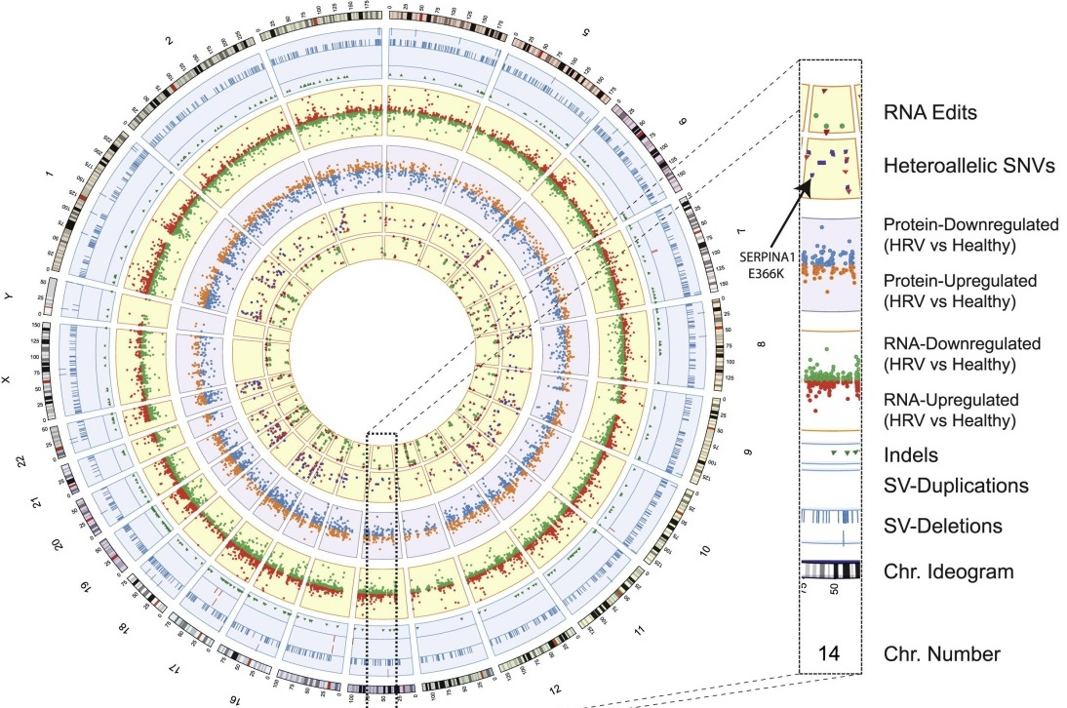
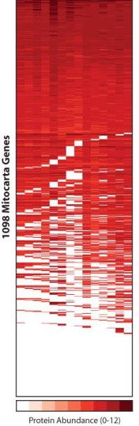
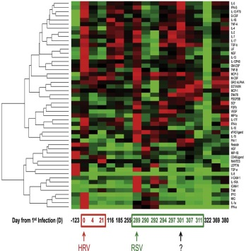
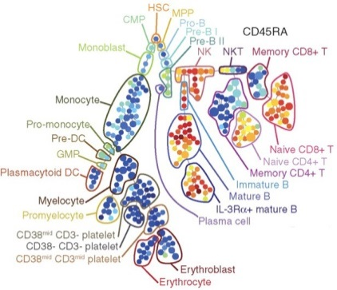
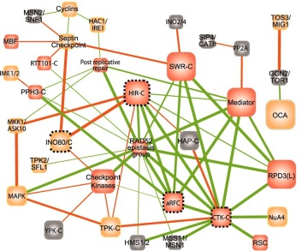
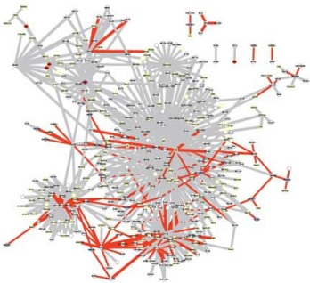
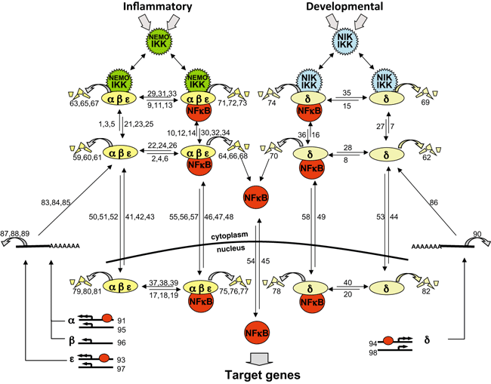
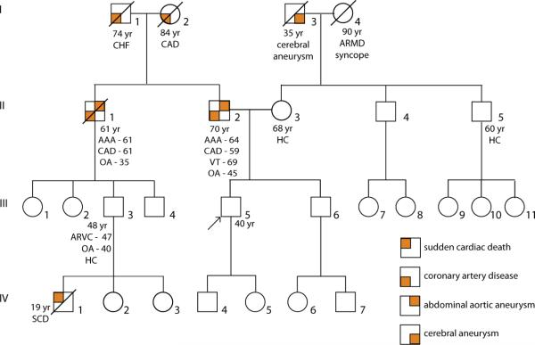
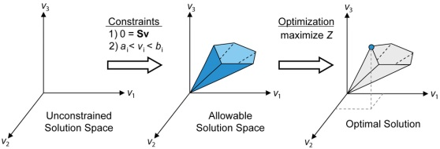

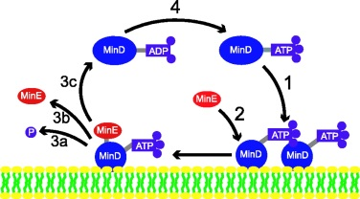
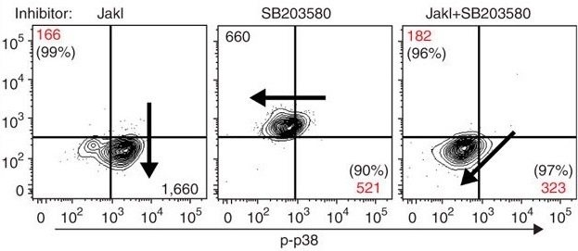






Molecular data is now available
Notes:
Protein expression: http://www.ncbi.nlm.nih.gov/pmc/articles/PMC2778844/figure/F4/

Slide 21
Integrative modeling methods are now available
Uptake
FBA
Composition
Metabolism
FBA
Composition
Transcription
Stochastic binding
Gene expression
Translation
Stochastic binding
Gene expression
Replication
Chemical kinetics
DNA sequence

Slide 22
WC modeling is now feasible
Molecular data
Integrative model
Notes:
A central challenge in cell biology is to understand the molecular basis of cellular behaviors, that is:
to understand how cellular behaviors arise from the interactions of biomolecules,
to understand how cellular processes are controlled and coordinated at the molecular level,
to understand how cells allocate limited molecular resources for growth and maintainence,
and more.

Slide 23
WC modeling progress
1970's Coarse-grained ODEs
1990's FBA
2000's Boolean models
2008
iFBA
2012
Multi-algorithm model

Slide 24
Outline
Motivation
What is a WC model?
Challenges
Model building
State-of-the-art
Software tools
Open challenges

Slide 25
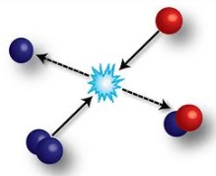
Challenge: multiple time and length scales
Growth
Length
Replication
Transcription
Metabolism
Time
Notes:
Lack of data
Time scales
Heterogeneity of experimental and computational methods across cell biology subfields
Lack of correlated measurements (cell properties measured independtely
Measurements are bulk (not single cells) (also obscures correlations, causation)

Slide 26
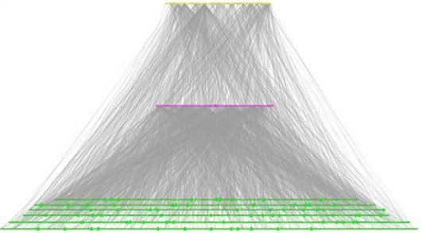
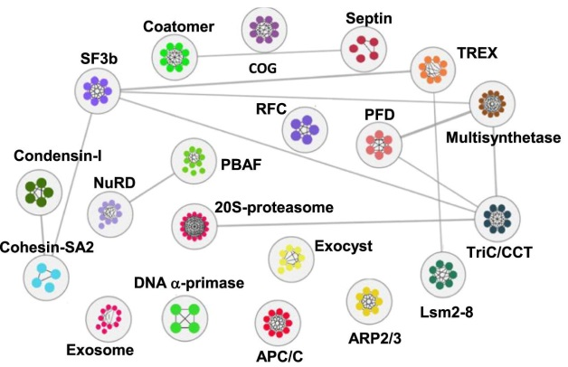
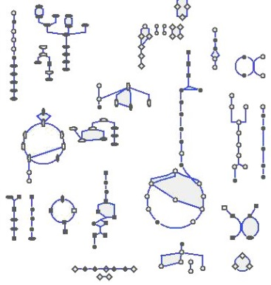
Challenge: heterogeneous networks
Transcriptional regulatory
Signaling
Metabolic
Notes:
Havugimana et al., 2012; Yan et al., 2010; Sachs et al., 2005; Orth et al., 2010

Slide 27
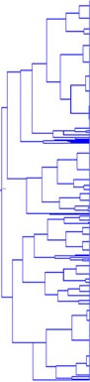
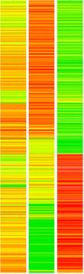
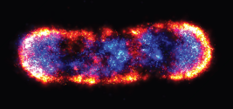
Challenge: heterogeneous data
Protein expression
Mass-spec, Western blot
Transcription
RNA-seq
Single-cell variation
Microscopy
Notes:
Lack of data
Time scales
Heterogeneity of experimental and computational methods across cell biology subfields
Lack of correlated measurements (cell properties measured independtely
Measurements are bulk (not single cells) (also obscures correlations, causation)

Slide 28
Challenge: sparse data
Notes:
Lack of data
Time scales
Heterogeneity of experimental and computational methods across cell biology subfields
Lack of correlated measurements (cell properties measured independtely
Measurements are bulk (not single cells) (also obscures correlations, causation)

Slide 29
Outline
Motivation
What is a WC model?
Challenges
Model building
State-of-the-art
Software tools
Open challenges

Slide 30
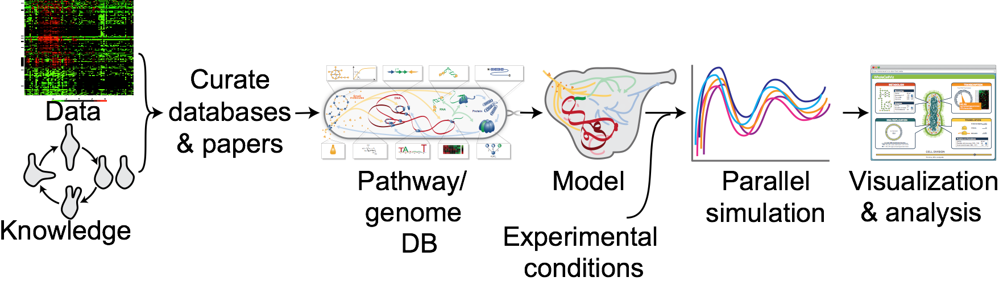
WC modeling process
Characterize organism
Aggregate data
Organize data
Design submodels
Merge submodels
Simulate model
Estimate parameters
Verify model
Validate model
Visualize/analyze predictions
Applications: Engineering, medicine

Slide 31
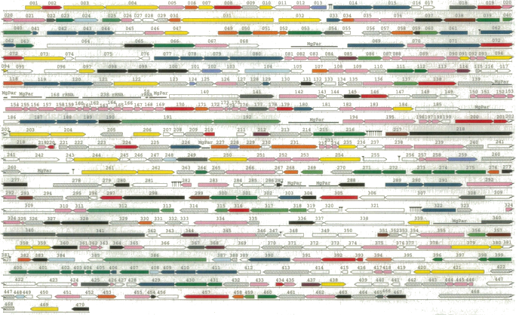
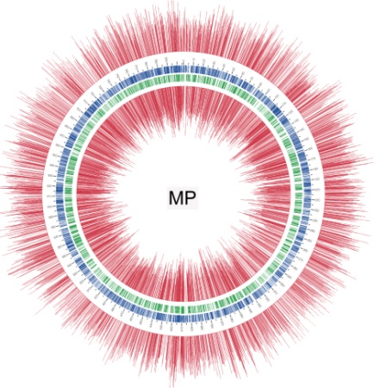
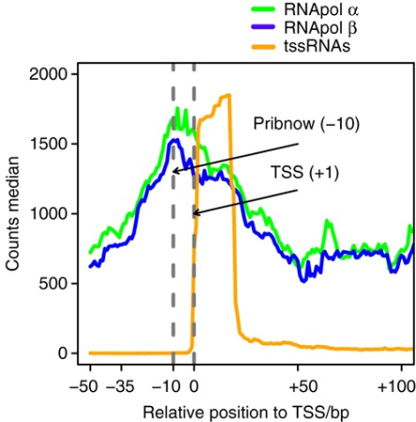
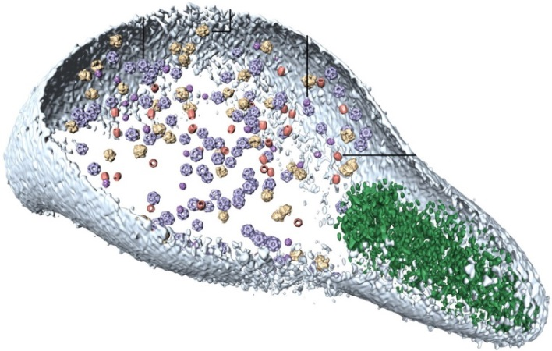
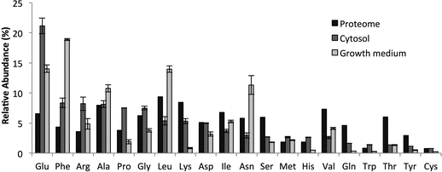
Step 1: Characterize organism
Genome
DNA-seq
Epigenome
Meth-seq
Transcriptome
RNA-seq
Proteome
Mass-spectrometry
Metabolome
Mass-spectrometry
Lectures: Genomics (Serrano, Lluch),
proteomics (Gavin), automation (Gardner)
Fraser et al., 1995; Kühner et al., 2009; Lluch-Senar et al., 2013; Maier et al., 2013; Yus et al. 2012

Slide 32
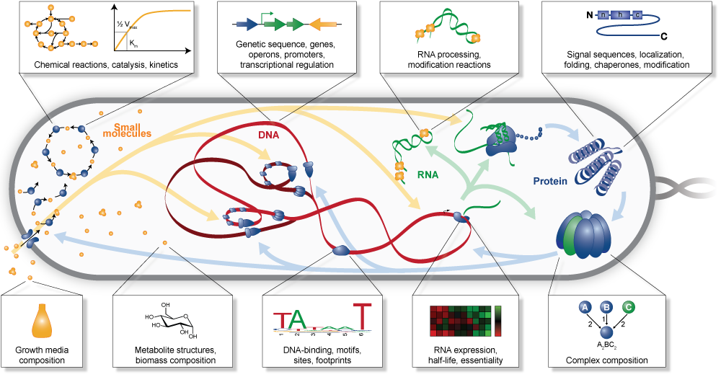
Step 2-3: Aggregate, organize data
Lectures: PGDBs, Pathway Tools, BioCyc (Peter Karp)
Karr et al., 2013

Slide 33
Step 4: Design submodels
1. Update RNA polymerase states
2. Calculate promoter affinities
Fur
HcrA
GntR
LuxR
Spx
Free
Promoter
Bound
Active
Bound
glpF
dnaJ
dnaK
gntR
trxB
polC
3. Bind RNA polymerase
4. Elongate and terminate transcripts
Sequence
AUGAUCCGUCUCUAAUGUCUAC
UTCAACGUGAGGUAAUAAAGUC
UCCACGAUGCUACUGUAUC
GCCUCAUACUGCGGAU
UUACGUAUCAGUGAUCAGUACU
Transcript
Notes:
Our 27 models are each based on extensive curation of the literature and are implemented separately using different mathematical representations. For example, we constructed the replication module by first considering the molecular mechanism of replication, interactions between replication and DNA, the enzymes involved in catalyzing replication, and the metabolic resources required for replication.
This motivated us to build a model of replication which would account for:
The formation of the replication bubble and DnaA complex disassembly at the oriC
DNA unwinding, replication bubble progression, and leading strand polymerization toward the terC
Discontinuous lagging strand primer and DNA polymerization
Okazaki fragment ligation
Interactions between DNA polymerase and other DNA-bound proteins and DNA damage
Next we built data structures which enable us to represent the specific location and size of all of the replication machinery and other DNA-bound proteins and DNA modifications and damages at each point in the cell cycle.
Finally we modeled the initiation, progression, and termination of replication as a set of rules governing the evolution of the state of the DNA, proteins, and metabolites.

Slide 34
Step 4: Design submodels
Biology: Metabolism, translation, signaling, cell division, and cell cycle;
Modeling formalisms: ODEs, FBA, stochastic, spatial, and logical modeling
Large-scale modeling techniques: rule-based modeling, standards

Slide 35
Step 5: Map submodels onto common state
Mass, shape
Uptake
FBA
Metabolite, RNA, protein counts
Composition
Metabolism
FBA
Transcript, polypeptide sequences
Composition
Transcription
Stochastic events
DNA polymerization,
proteins, modifications
Gene expression
Translation
Stochastic events
Gene expression
FtsZ ring
Replication
Chemical kinetics
Mammalian host
DNA sequence
States
Submodels
Lectures: Rule-based modeling (James Faeder), model composition (Yin Hoon Chew)
Notes:
Second, recognizing the modularity of biology and the separation of time scales of biological processes, we built our model by composition enabling us at short time scales to model each cellular process independently, using the most appropriate mathematical representation and experimental data for each cellular process.
- Separation of time scales
- Choose appropriate representations and parameterizations
- Creatively decouple representations
Computational reconcile and decouple parameters
A module is:
Independent physiologic function
Independent enzyme complement
Internal time scale faster than time scales of interactions with other modules
Factorization of state space and transfer functions
Module methods:
Time evolution
Interface to core simulation -- references to metabolites, enyzmes; RNAs, proteins, etc.
Resource (energy) requirement during simulation
Initial conditions
Fit growth rate
Expected resource requirements (contribution metabolism objective)
Pre-processing, memory allocation
Options, parameters, indices, pre-processed data, predicted time courses
Plotting, printing, saving, loading

Slide 36
Step 6: Concurrently integrate submodels
Uptake
Uptake
Uptake
Metabolism
Metabolism
Metabolism
Cell states
Cell states
Cell states
Transcription
Transcription
Transcription
Translation
Translation
Translation
Replication
Replication
Replication
1 s
Lectures: Multi-algorithm modeling (Jonathan Karr)
Notes:
Our model is then executed by first executing 28 individual models of cellular processes at a 1 s time scale, second integrating the inputs and outputs of the individual models, for example, and finally repeating this process tens of thousands of times across the length of the Mycoplasma genitalium cell cycle.

Slide 37
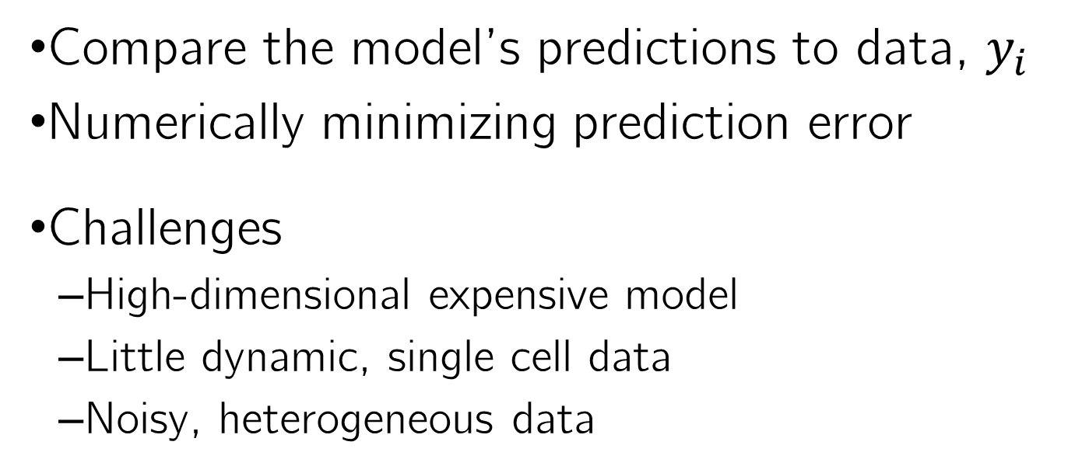
Step 7: Estimate parameters
Compare the model’s predictions to data, $y_{i}$
Numerically minimizing prediction error
Challenges
High-dimensional expensive model
Little dynamic, single cell data
Noisy, heterogeneous data
Lectures: Data integration (Yin Hoon Chew)

Slide 38
Step 7: Estimate parameters
Reduce model
Identify reduced model parameters using traditional methods
Experiment
Model
Molecule
Molecule
Manually tune parameters using full model
Cell
Time

Slide 39
Steps 8-9: Verify and validate model
Verify: known biology
Validate: true biology
Matches training data
Matches published data
Matches theory
No obvious errors
Matches new data
Notes:
3151 simulations (192 wt, 2959 deletions)

Slide 40
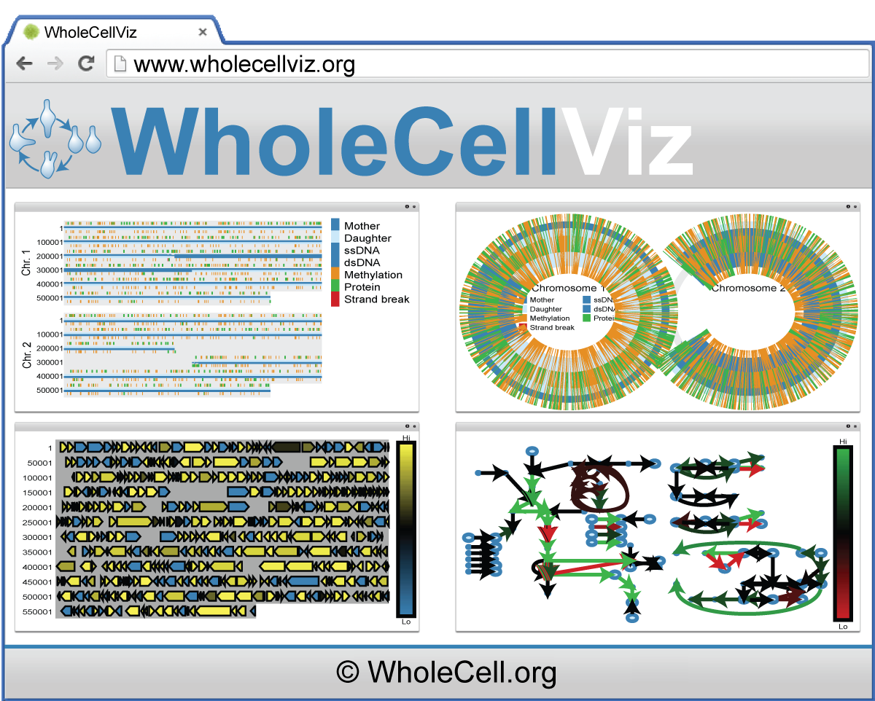
Steps 10-11: Visualize, analyze, discover & engineer

Slide 41
Outline
Motivation
What is a WC model?
Challenges
Model building
State-of-the-art
Software tools
Open challenges

Slide 42
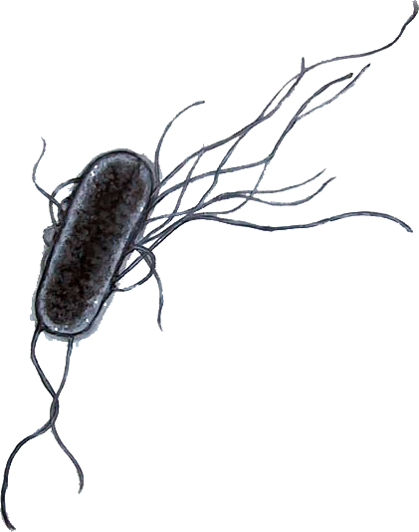
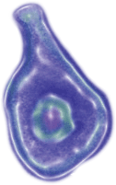
Example: Mycoplasma genitalium WC model
 | E. coli | M. genitalium
Genome | 4700 kb | 580 kb
Genes | 4461 | 525
Size | 2 μm × 0.5 μm | 0.2-0.3 μm
Notes:
http://www.pbs.org/wgbh/nova/sciencenow/dispatches/images/050707-mgenitalium.jpg
Tractable genome
75% annotated
Little overlapping function
Genomic synthesis
Genome-scale datasets

Slide 43
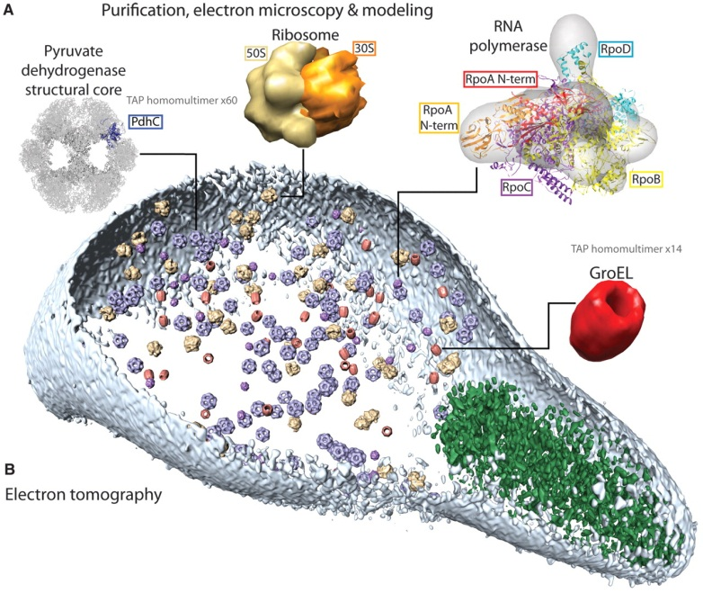
Mycoplasmas are well-characterized
Genomic-scale data
Kühner et. al, 2009

Slide 44
Model includes 28 pathway submodels
Karr et al., 2012

Slide 45
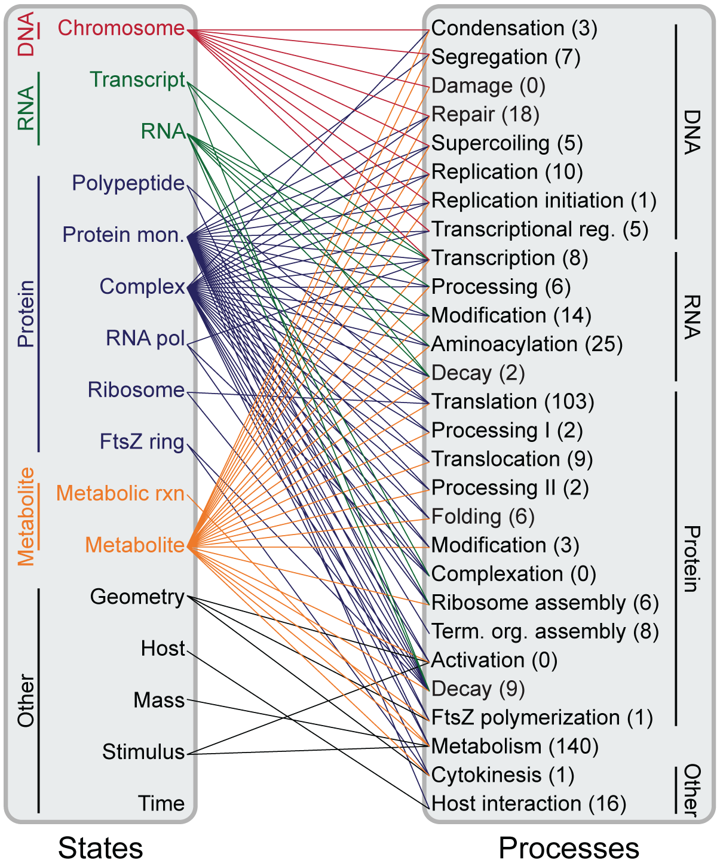
Submodels are mapped onto 16 common states
Karr et al., 2012

Slide 46
Model represents 76% of genes
Condensation
Segregation
Damage
Repair
Replication
Rep Init
Trans Reg
Degradation
Modification
Processing
Transcription
Aminoacylation
Complexation
Activation
Degradation
Folding
Modification
Processing I
Processing II
Translocation
Ribosome
Term Org
Translation
Shape
Cytokinesis
FtsZ
Metabolism
DNA
RNA
Protein
Other

Slide 47
Model statistics
Model
525 genes
700 proteins
600 metabolites
1,800 reactions
1,900 parameters
930 citations
Code
163,590 lines (34,380 model)
2,172 revisions
3,151 published simulations
1.5 TB compressed
24+ cpu yr to fit model
Languages
MATLAB
Python, JavaScript, HTML, MySQL
Perl, Shell

Slide 48
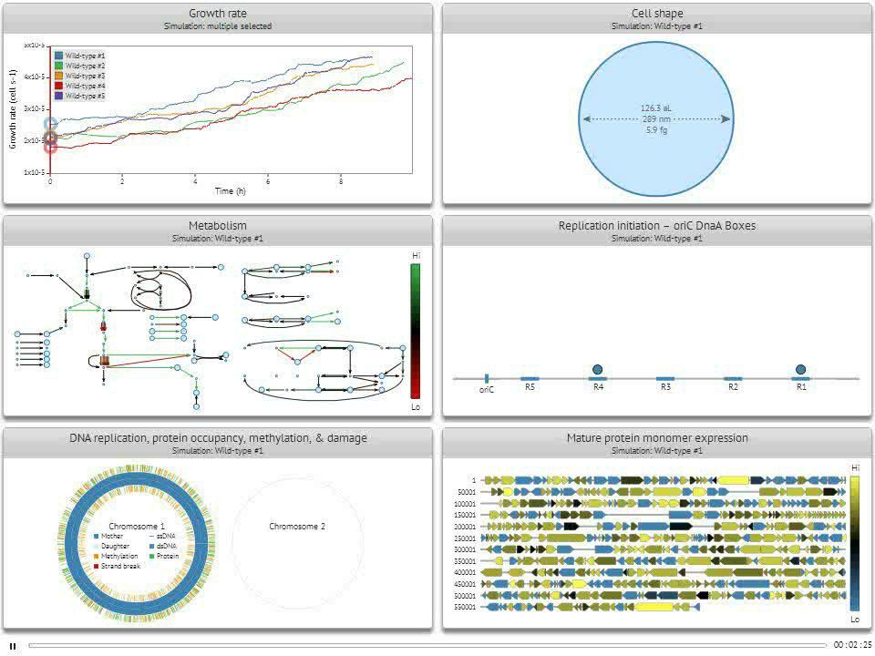

Slide 49
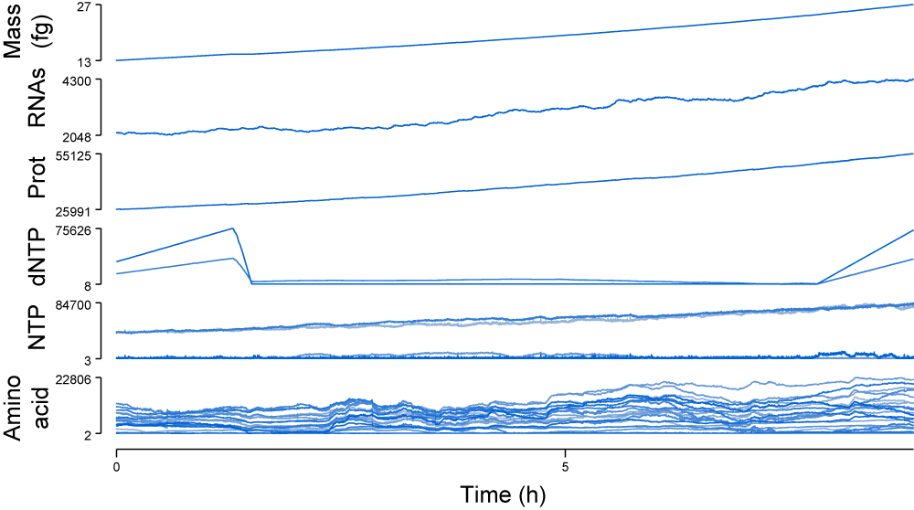
Predicted cell composition

Slide 50
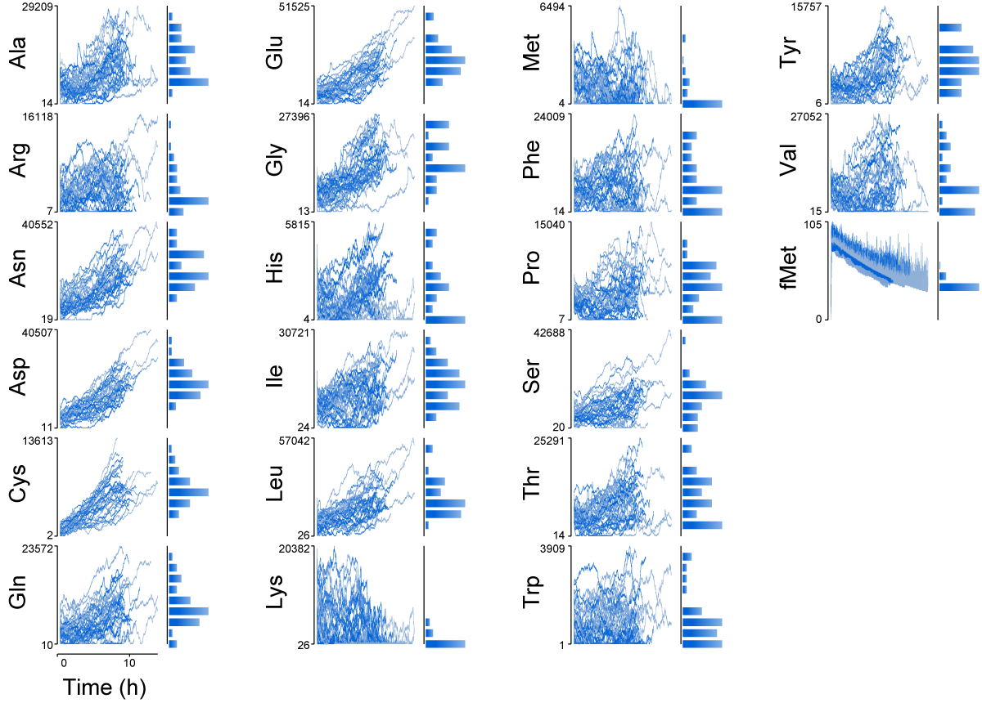
Predicted metabolite concentrations

Slide 51
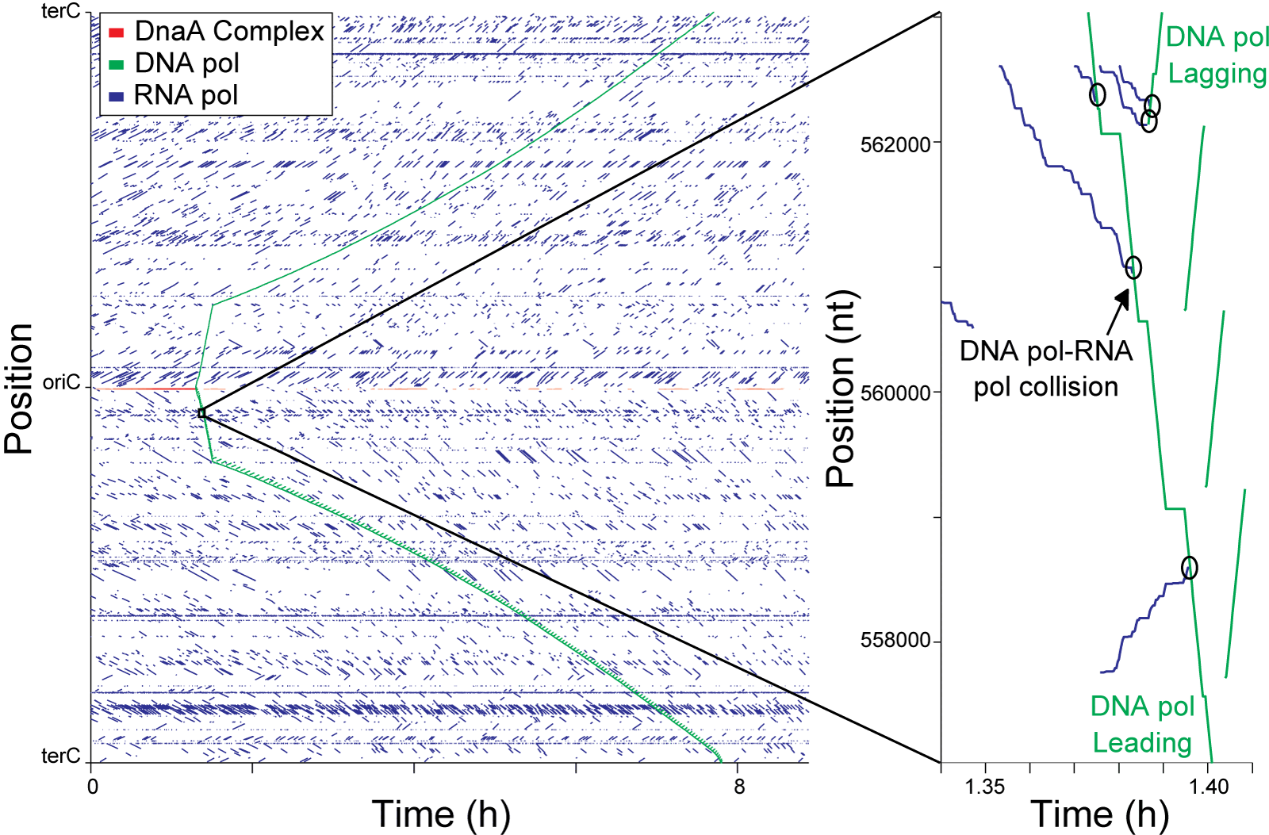
Predicted DNA binding protein collisions
Karr et al., 2012

Slide 52
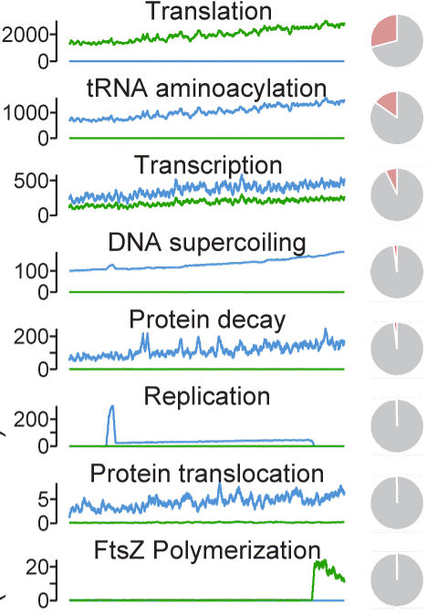
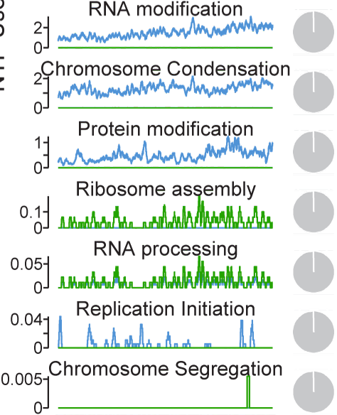

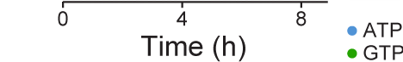
Predicted energy consumption
v
v
Karr et al., 2012

Slide 53
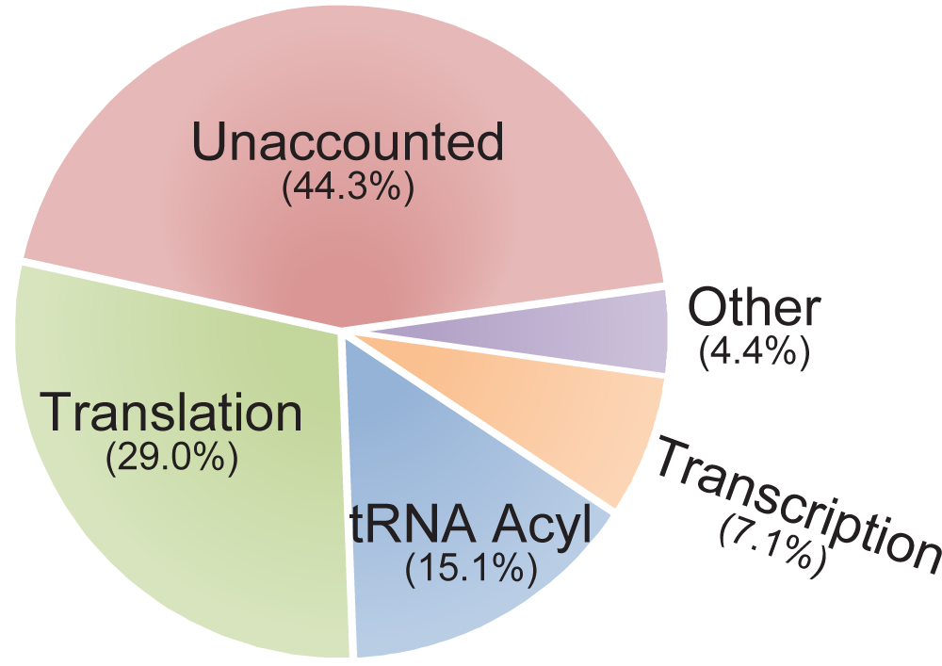
Predicted energy consumption
60 m mol ATP / gDCW
80 a mol ATP / cell
Notes:
50 million ATP / cell
80 atto mol ATP / cell
60 m mol ATP / gDCW

Slide 54
Example: growth optimization
What genomic modifications maximize growth?
Mass
Time

Slide 55
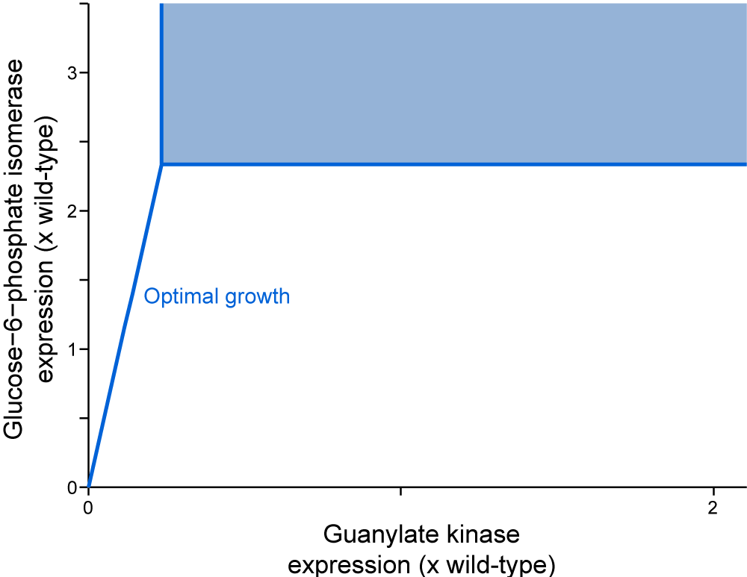
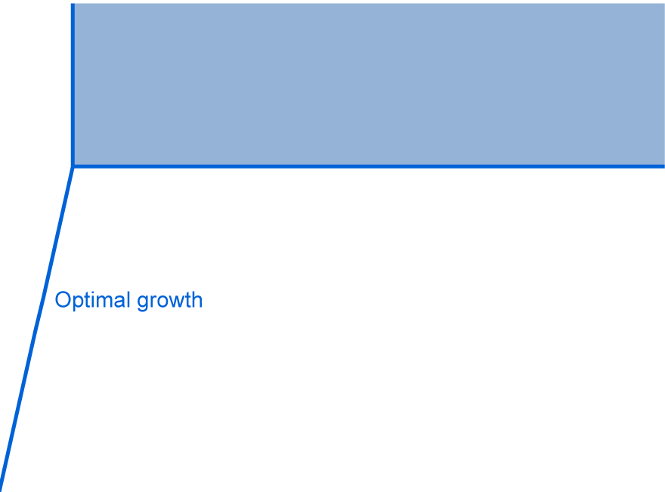
Optimal gene expression

Slide 56






Optimal gene expression
M. mycoides
M. pneumoniae
M. genitalium

Slide 57




Optimal gene expression retains robustness
Optimal architecture retains robustness

Slide 58

Drug repositioning
Kazakiewicz et al., 2015

Slide 59
Outline
Motivation
What is a WC model?
Challenges
Model building
State-of-the-art
Software tools
Open challenges

Slide 60
WC modeling software
Pathway/genome databases
Pathway Tools: biocyc.org
WC-KB: wholecellkb.org
Modeling languages
SBML: sbml.org
CellML: cellml.org
Integrative modeling
E-Cell: e-cell.org
Whole-cell: wholecell.org
Simulation results visualization
WC-SimDB: wholecellsimdb.org
WC-Viz: wholecellviz.org

Slide 61
Outline
Motivation
What is a WC model?
Challenges
Model building
State-of-the-art
Software tools
Open challenges

Slide 62

Limitations of existing methods

Slide 63

Limitations of existing methods

Slide 64
Limitations of existing methods
Limited scope and accuracy
Don’t represent several cell functions
Don’t predict several phenotypes
Methods are not rigorous
Multi-algorithm simulation
Parameter estimation
Verification
Model reduction
Time-consuming to construct
Curate data
Design model
Verify model
Hard to understand, reuse, reproduce

Slide 65
Open challenges
Experimental characterization and data aggregation
Comprehensive metabolomic, proteomic, kinetic measurements
Data annotation, deposition
Systemizing and accelerating WC modeling
Data curation tools
WC modeling language
Formal verification
High-performance simulator
Modeling more complex physiology
Regulatory pathways
Larger volumes, genomes
Spatial organization
Multicellularity
Longer time scales: aging, evolution
Using models to direct engineering and medicine
Algorithms to optimize phenotypes
Large-scale genome engineering methods
Medical decision support

Slide 66
Summary
Data
Integrative model
Broadly predicts cell physiology
Integrates heterogeneous data and models
Guides bioengineering and medicine
Opportunities to develop improved methods
Notes:
A central challenge in cell biology is to understand the molecular basis of cellular behaviors, that is:
to understand how cellular behaviors arise from the interactions of biomolecules,
to understand how cellular processes are controlled and coordinated at the molecular level,
to understand how cells allocate limited molecular resources for growth and maintainence,
and more.

Slide 67











Acknowledgements
Anne Marie Barrette
Yin Hoon Chew
Arthur Goldberg
Graeme Gossel
Pablo Meyer
IBM/Sinai
Roger Rodriguez
UNAM
Center for Regulatory Genomics
Luis Serrano
Maria Lluch-Senar
Veronica Llorens

